Slide 1
Logaritmos

Slide 2
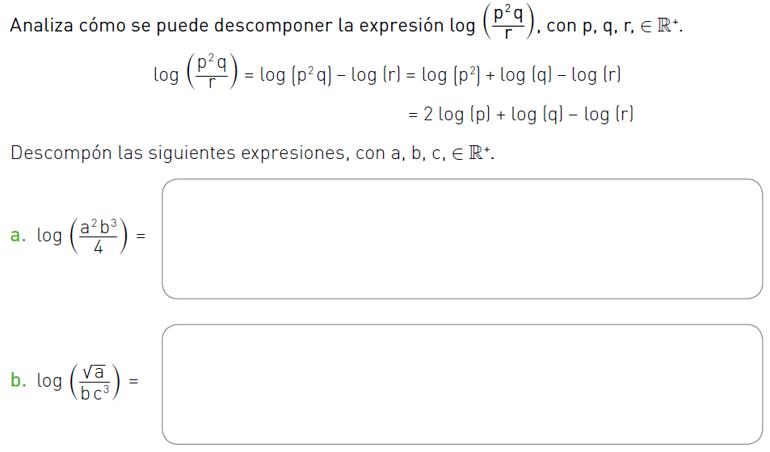







$\log{a^{2}b^{3}−log}4$
$\log{a^{2}+log b^{3}−log}4$
$2log{a+3log b−log}4$
$\log{\sqrt{a}−log}(bc^{3})$
$\log{\sqrt{a}−(log b+log}c^{3})$
$\frac{1}{2}log{a−log b−3log}c$
$\log{a^{\frac{1}{2}}−(log b+3log}c)$

Slide 3
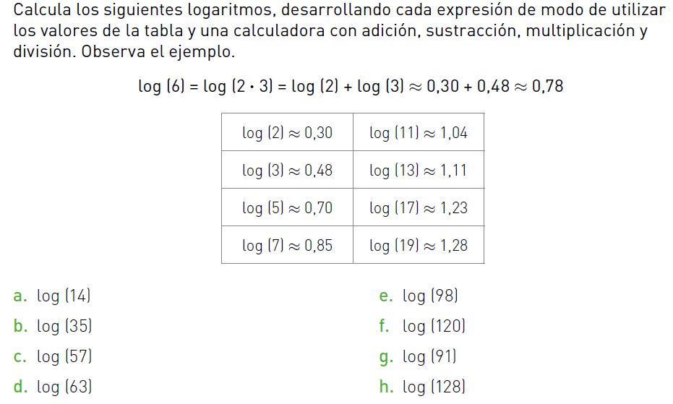








$$=1,15$$
$$=2$$
$$=1,55$$
$$=1,78$$
$$=1,76$$
$$=1,96$$
$$=1,81$$
$$=2,1$$

Slide 4
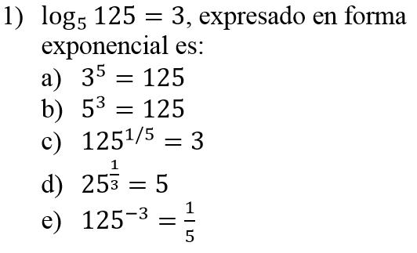
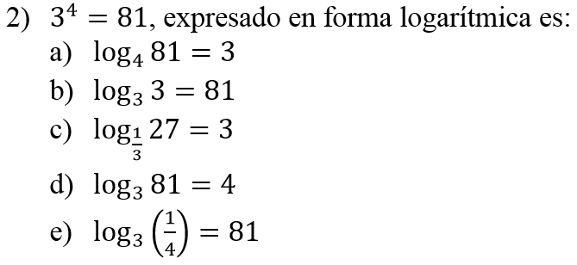

Slide 5
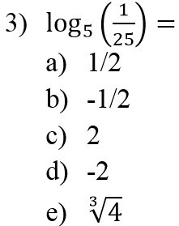
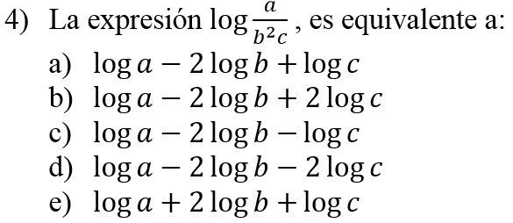

Slide 6
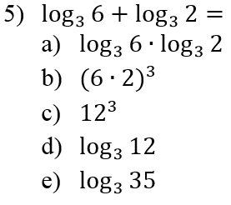
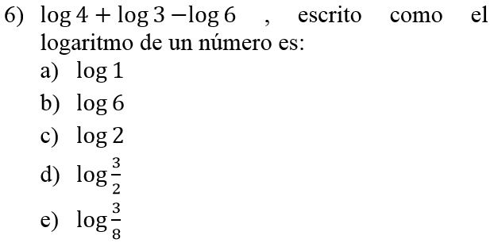
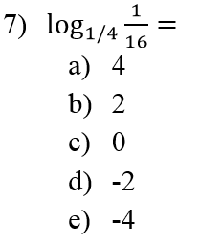

Slide 7
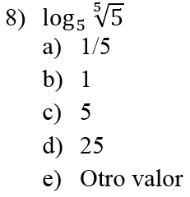
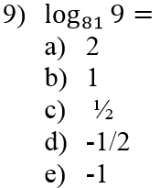
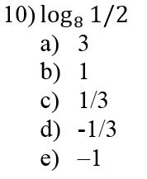

Slide 8
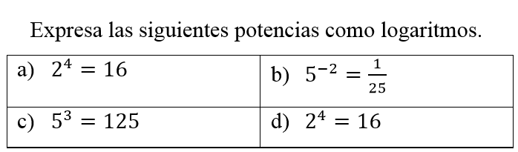
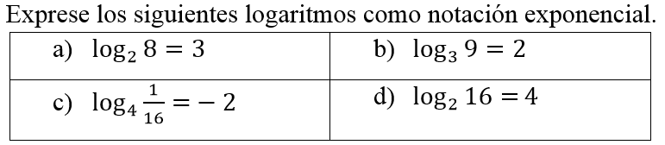

Slide 9
