Slide 1
Geometría 3d
Matemática
23 / 06 /2020

Slide 2
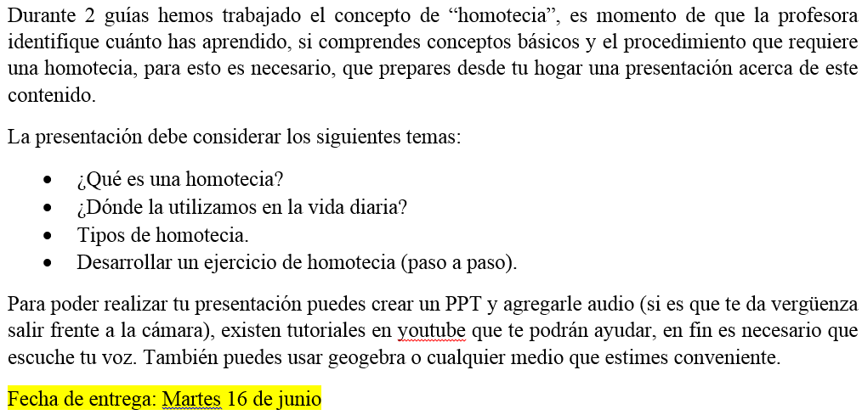
GEOMETRÍA 3D

Slide 3
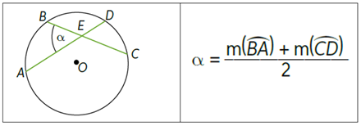
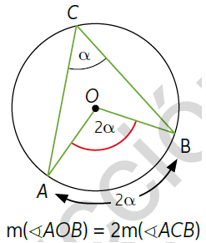
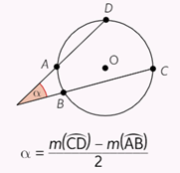
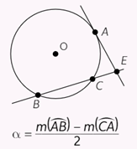
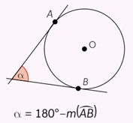
MATEMÁTICA

Slide 4
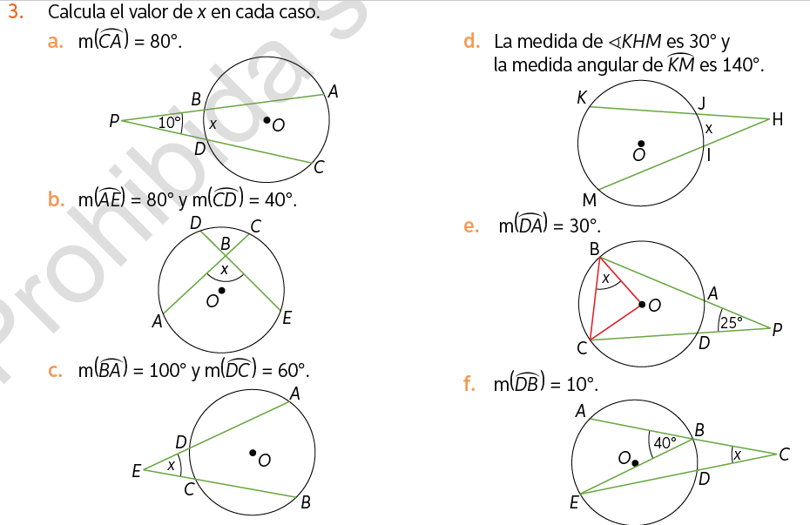

Slide 5
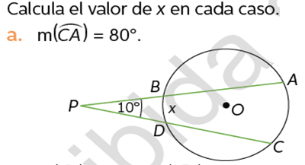







$$α=\frac{m(\hat{CA})−m(\hat{DB})}{2}$$
$$10°=\frac{80°−m(\hat{DB})}{2}$$
$$80°$$
$$20°=80°−m(\hat{DB})$$
$$20°−80°=−m(\hat{DB})$$
$$−60°=−m(\hat{DB})$$
$$m\left(\hat{DB}\right)=60°$$

Slide 6
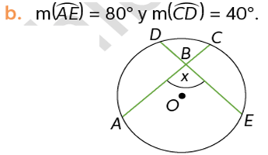






$$α=\frac{m\left(\hat{AE}\right)+m(\hat{CD})}{2}$$
$$40°$$
$$α=\frac{80°+40°}{2}$$
$$α=\frac{120°}{2}$$
$$80°$$
$$α=60°$$

Slide 7
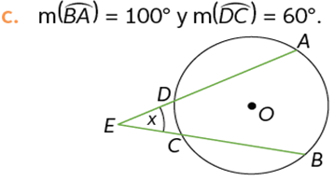






$$α=\frac{m\left(\hat{BA}\right)−m(\hat{DC})}{2}$$
$$100°$$
$$α=\frac{100−60}{2}$$
$$60°$$
$$α=\frac{40}{2}$$
$$α=20°$$

Slide 8
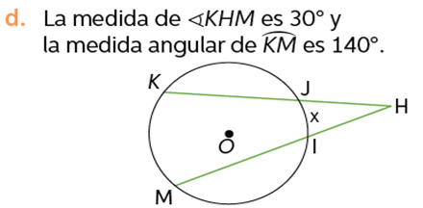






$$α=\frac{m\left(\hat{MK}\right)−m(\hat{IJ})}{2}$$
30°°
140°°
$$30°=\frac{140°−m(\hat{IJ})}{2}$$
$60°=$ $140°−m(\hat{IJ})$
$$60°−140°=−m(\hat{IJ})$$
$$−80°=−m(\hat{IJ})$$
$$m\left(\hat{IJ}\right)=80°$$

Slide 9
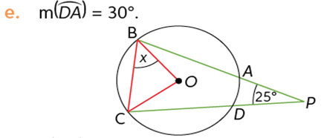







$$α=\frac{m\left(\hat{BC}\right)−m(\hat{DA})}{2}$$
80°
80°
$$25°=\frac{m(\hat{BC})−30}{2}$$
30°
$50°=$ $m\left(\hat{BC}\right)−30$
$$180°−80°=100°$$
$$50°+30°=m(\hat{BC})$$
$$100° : 2 =50$$
$$80°=m(\hat{BC})$$

Slide 10
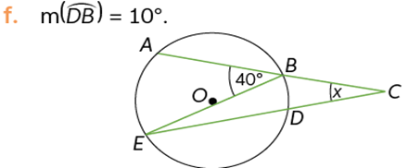






$$α=\frac{m\left(AE\right)−m(DB)}{2}$$
$$80°$$
$$10°$$
$$α=\frac{80°−10°}{2}$$
$$α=\frac{70°}{2}$$
$$α=35°$$

Slide 11
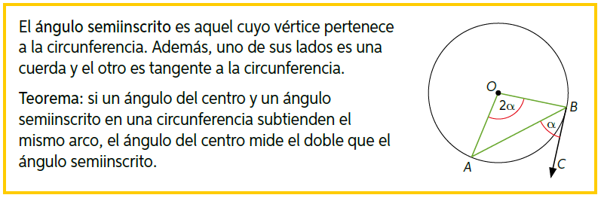

Slide 12
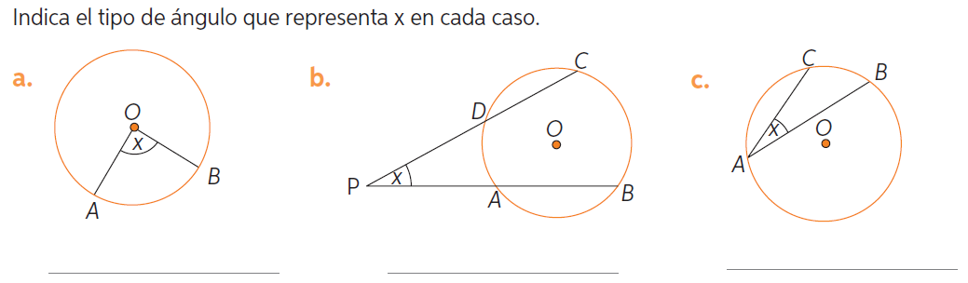

Slide 13
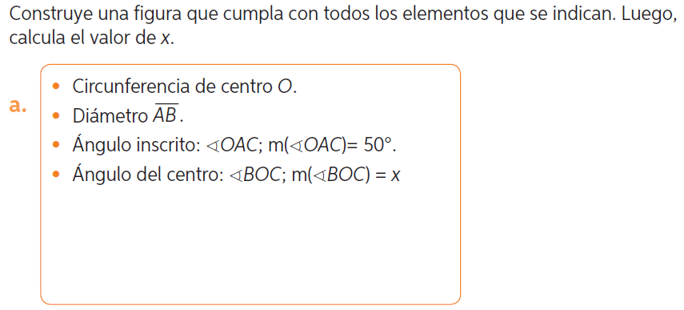

Slide 14
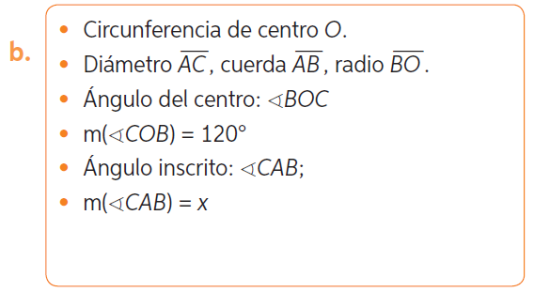

Slide 15
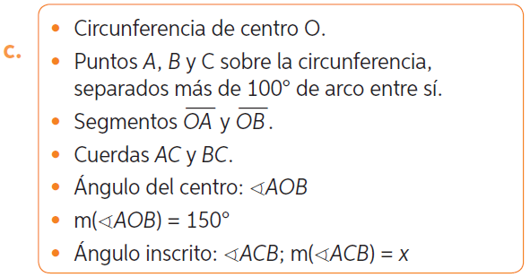

Slide 16
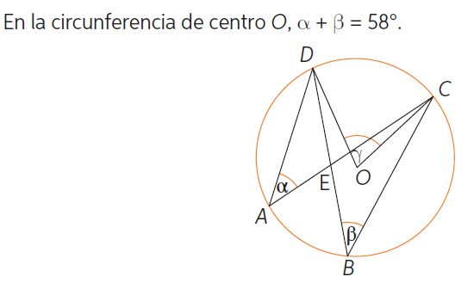

Slide 17
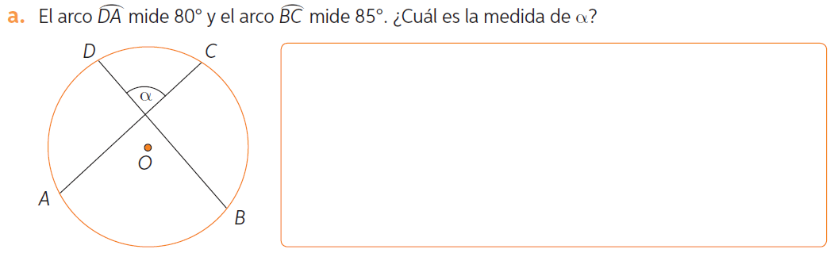

Slide 18
