Slide 1
POTENCIAS DE BASE RACIONAL
25/06

Slide 2
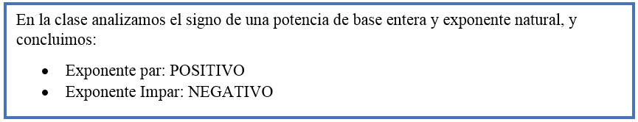
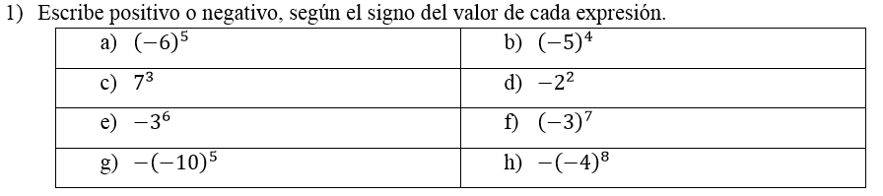
NEGATIVO
POSITIVO
POSITIVO
NEGATIVO
NEGATIVO
NEGATIVO
POSITIVO
NEGATIVO

Slide 3
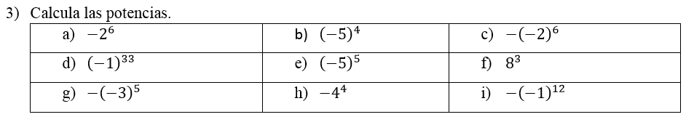
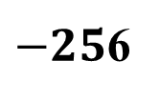


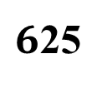





$$−64$$
$6$25
$$64$$
$$−1$$
$$−3125$$
$$512$$
$$243$$
$−25$6
$$−1$$

Slide 4
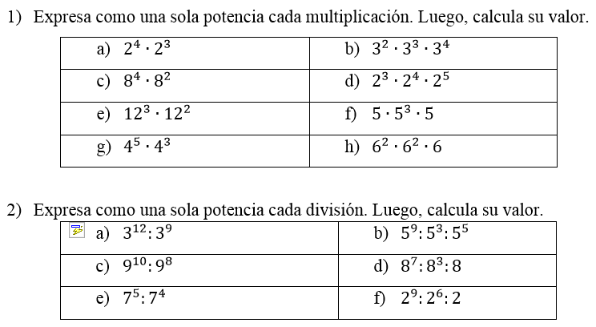















$$2^{4+4}$$
$$2^{8}$$
256
$$3^{2+3+4}=3^{9}$$
$$8^{4+2}=8^{6}$$
$$2^{3+4+5}=2^{12}$$
$${12}^{3+2}={12}^{5}$$
$$5^{1+3+1}=5^{5}$$
$$4^{5+3}=4^{8}$$
$$6^{2+2+1}=6^{5}$$
$$3^{12−9}=3^{3}=27$$
$$5^{9−3−5}=5^{1}$$
$$9^{10−8}=9^{2}$$
$$8^{7−3−1}=8^{3}$$
$$7^{5−4}=7^{1}$$
$$2^{9−6−1}=2^{2}$$

Slide 5
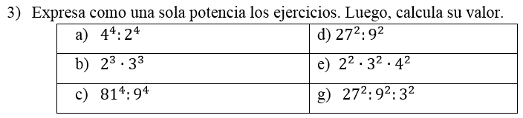






$${(4:2)}^{4}=2^{4}=16$$
$${(27:9)}^{2}=3^{2}=9$$
$${(2∙3)}^{3}=6^{3}=216$$
$${(2∙3∙4)}^{2}={24}^{2}$$
$${(81:9)}^{4}=9^{4}=6561$$
$${(27:9)}^{2}=3^{2}:3^{2}=1$$

Slide 6









POTENCIAS DE BASE RACIONAL
$${\left(\frac{2}{3}\right)}^{3}$$
$$=\left(\frac{2}{3}\right)∙\left(\frac{2}{3}\right)∙\left(\frac{2}{3}\right)$$
$$=\frac{8}{27}$$
$${\left(−\frac{3}{2}\right)}^{4}$$
$$=\left(−\frac{3}{2}\right)∙\left(−\frac{3}{2}\right)∙\left(−\frac{3}{2}\right)∙\left(−\frac{3}{2}\right)$$
$$=\frac{81}{16}$$
$${0,5}^{2}$$
$$=0,5∙0,5$$
$$=0,25$$

Slide 7
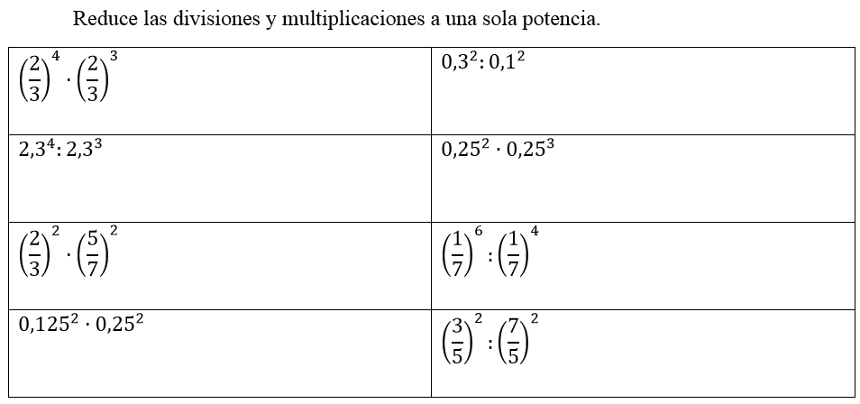

Slide 8
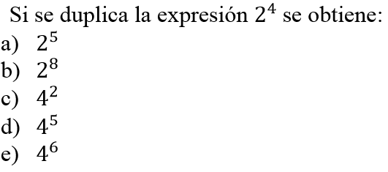

MARCA LA ALTERNATIVA CORRECTA
$$A$$

Slide 9
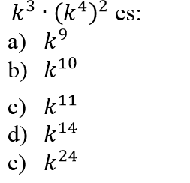

$$C$$

Slide 10
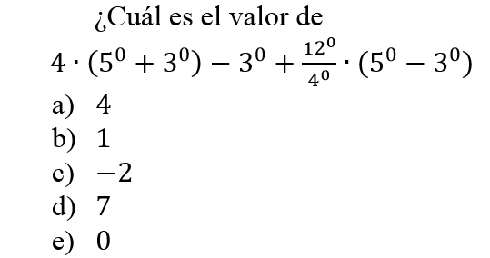

$$D$$

Slide 11
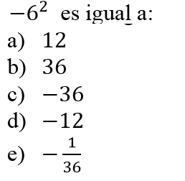

$$C$$

Slide 12
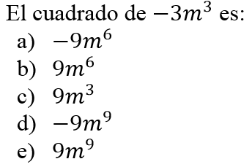

$$B$$

Slide 13
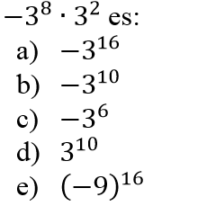

$$B$$

Slide 14
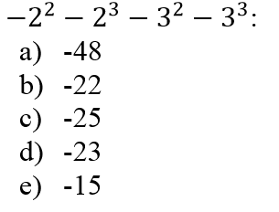

$$A$$

Slide 15
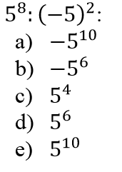

$$D$$

Slide 16
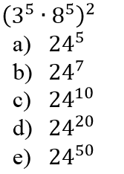

$$C$$

Slide 17
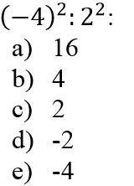

$$B$$

Slide 18
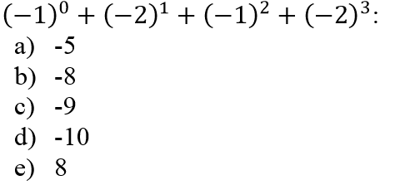

$$B$$

