Slide 1
Retroalimentación guía
23-06-2020

Slide 2
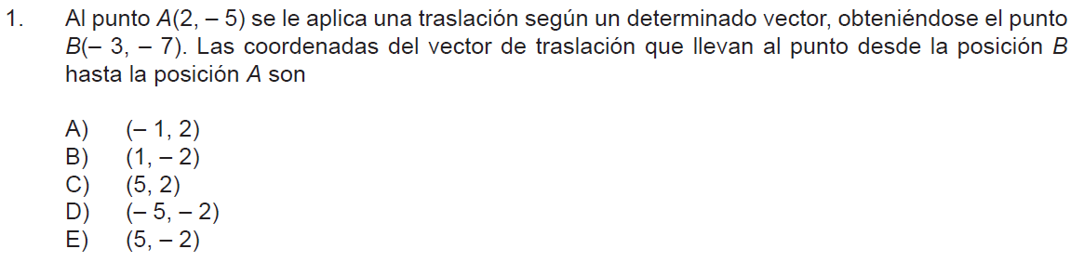
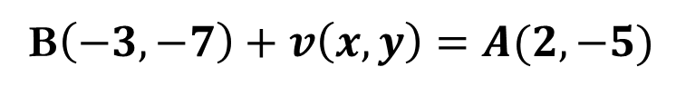


B$\left(−3,−7\right)+v\left(x,y\right)=A(2,−5)$
$$v\left(x,y\right)=\left(2,−5\right)−\left(−3,−7\right)$$
$$v\left(x,y\right)=\left(5,2\right)$$

Slide 3
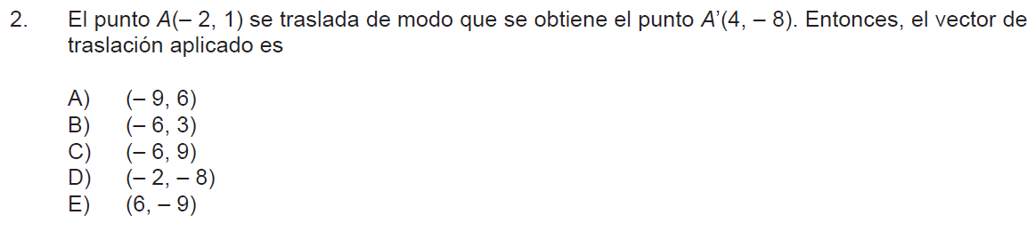



$$A\left(−2,1\right)+v\left(x,y\right)=(4,−8)$$
$$v\left(x,y\right)=\left(4,−8\right)−(−2,1)$$
$$v\left(x,y\right)=\left(6,−9\right)$$

Slide 4
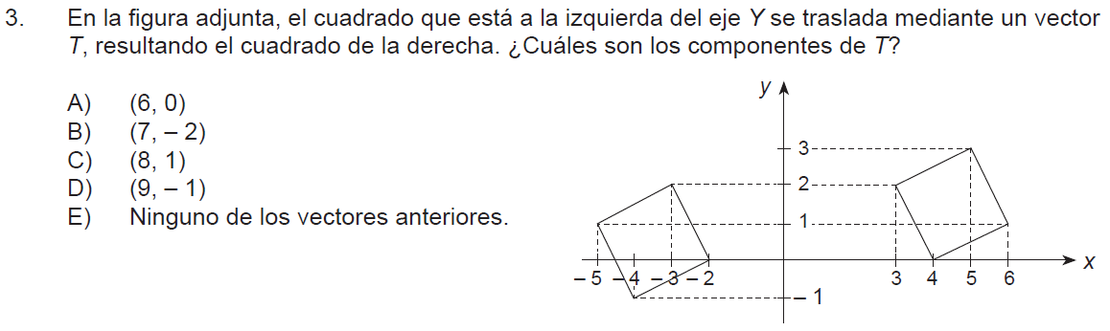



$$\left(−5,1\right)+v\left(x,y\right)=(3,2)$$
$$v\left(x,y\right)=\left(3,2\right)−\left(−5,1\right)$$
$$v\left(x,y\right)=\left(8,1\right)$$

Slide 5
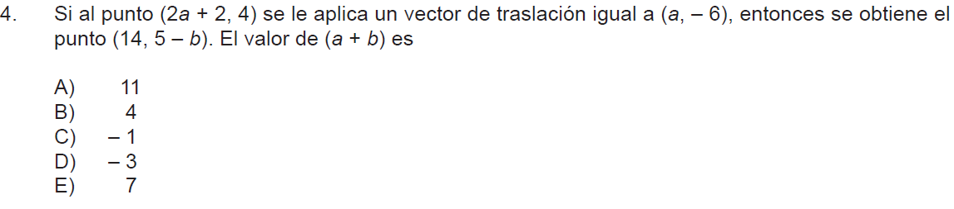



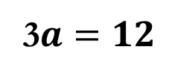





$$\left(2a+2 ,4\right)+\left(a ,−6\right)=(14 ,5−b)$$
$$2a+2+a=14$$
$$2a+a=14−2$$
3$a=12$
$$a=4$$
$$a+b=4+7=11$$
$$4−6=5−b$$
$$−2−5=−b$$
$$−7=−b$$
$$b=7$$

Slide 6
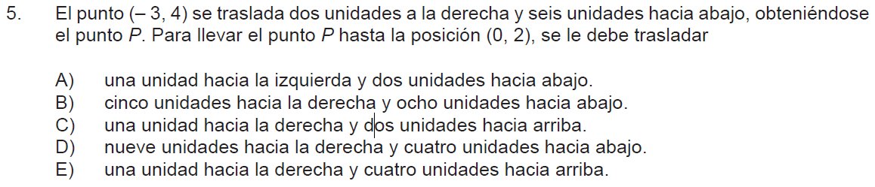




$$\left(−3,4\right)+(2,−6)=(−1,−2)$$
$$\left(−1,−2\right)+(x,y)=(0,2)$$
$$\left(x,y\right)=\left(0,2\right)−(−1,−2)$$
$$(x,y)=(1,4)$$

Slide 7
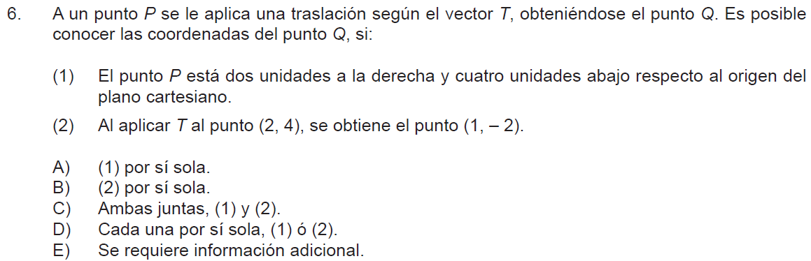

$$P\left(x,y\right)+T(x_{1},y_{1})=Q(x_{2},y_{2})$$

Slide 8
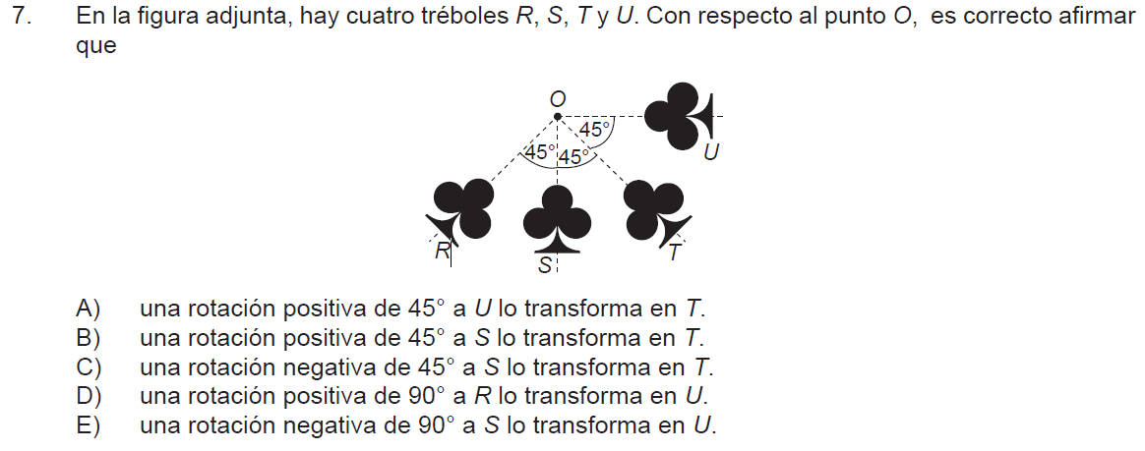
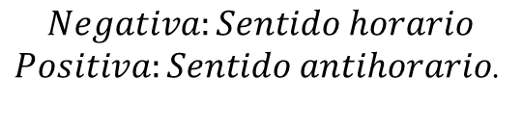
$$Negativa:Sentido horario$$
$Positiva:Sentido antihorario$.

Slide 9
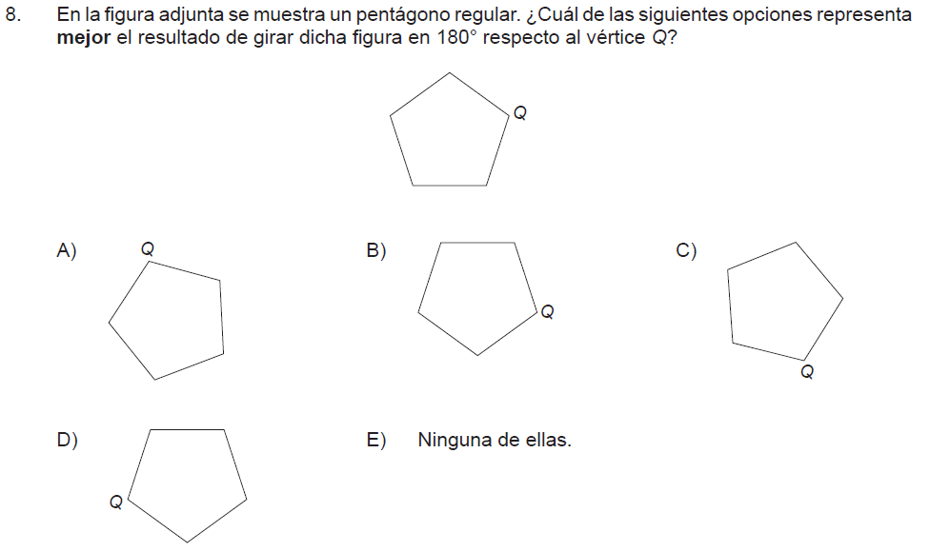

Slide 10
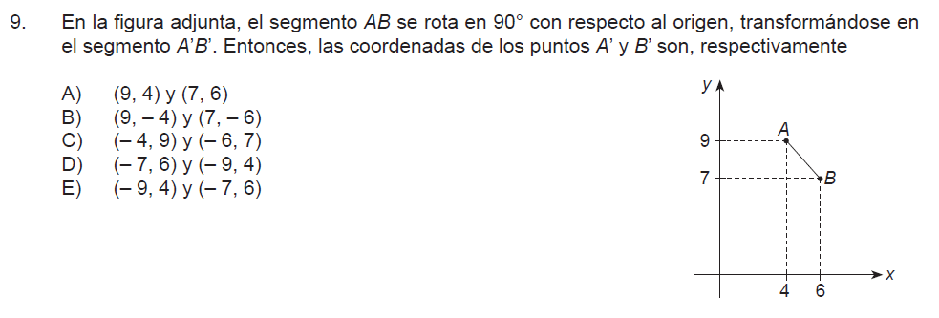



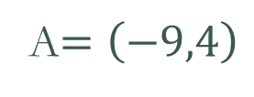

$$90°=\left(−b,a\right)$$
$$A=\left(4,9\right)$$
A$=\left(−9,4\right)$
$$B=\left(−7,6\right)$$
$$B=\left(6,7\right)$$

Slide 11
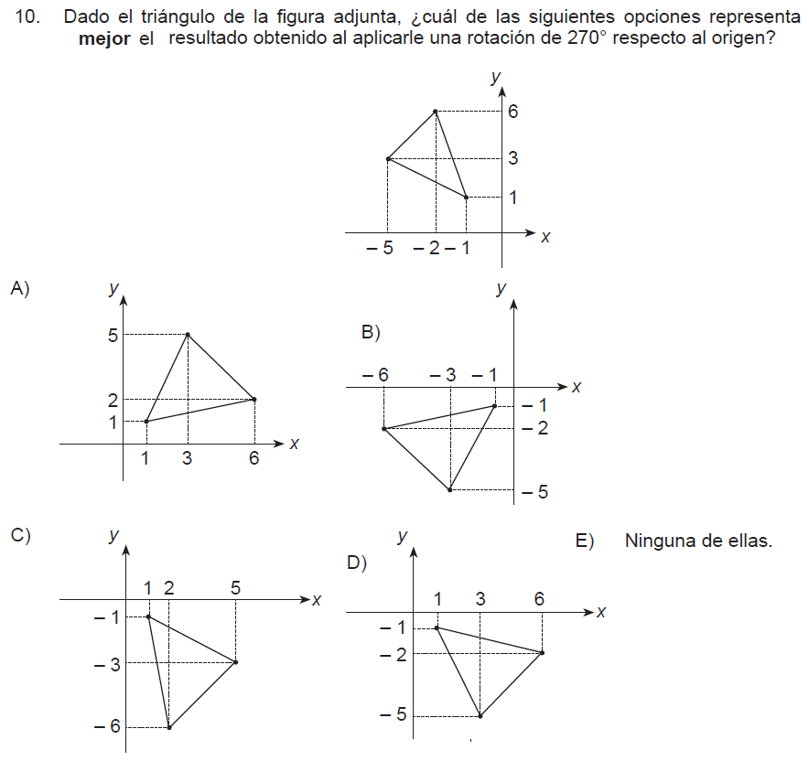



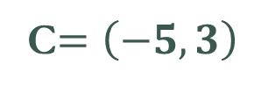
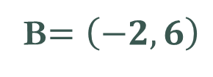


$$270°=\left(b,−a\right)$$
$$A=\left(−1,1\right)$$
$$A′=\left(1,1\right)$$
B$=\left(−2,6\right)$
$$B′=\left(6,2\right)$$
C$=\left(−5,3\right)$
$$C´=\left(3,5\right)$$

Slide 12
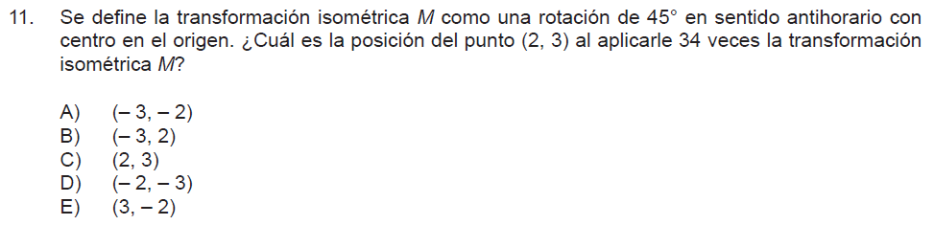




$$45∙34=1530$$
$$1530−\left(360∙4\right)=90°$$
$$90°=\left(−b,a\right)$$
$$(2,3)=\left(−3,2\right)$$

Slide 13
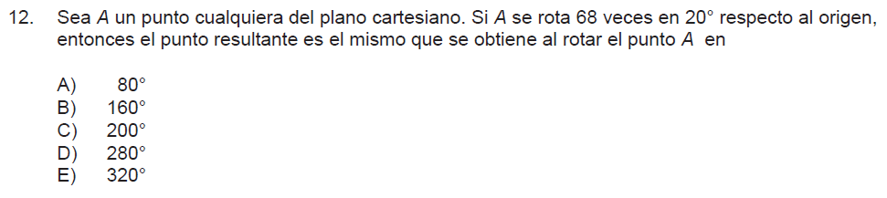



$$68∙20=1360$$
$$1360:360=3,777…$$
$$1360−(3∙360)=280$$

Slide 14
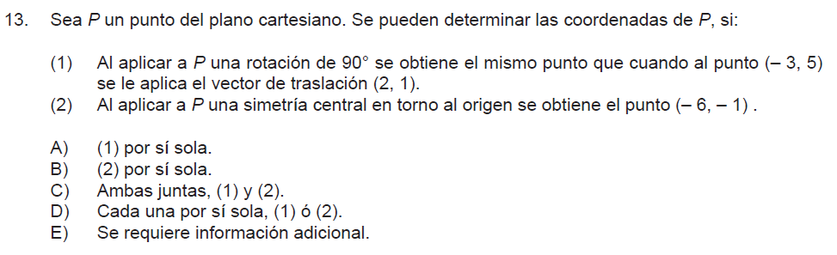

Slide 15
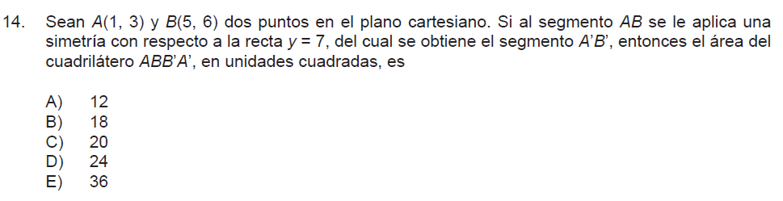
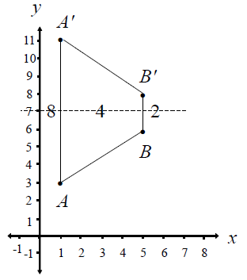


Slide 16
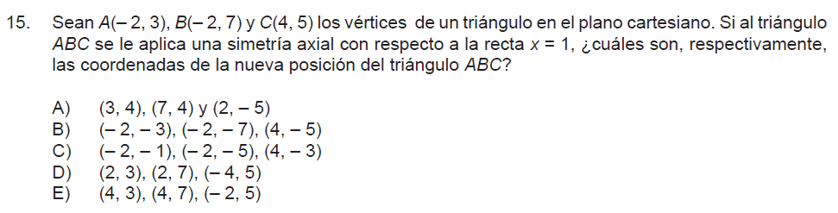
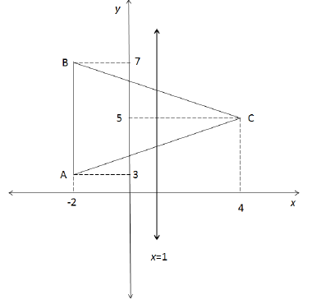

Slide 17
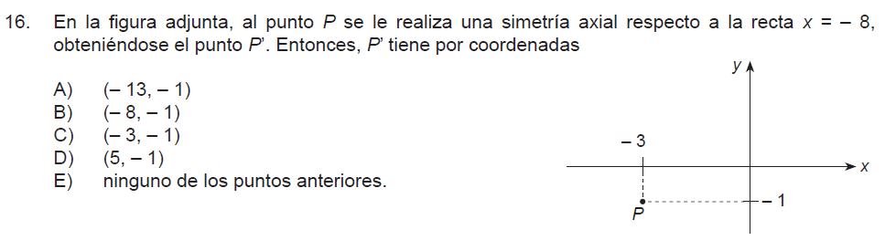
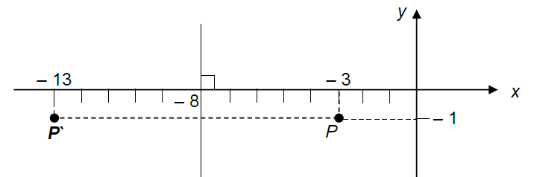

Slide 18
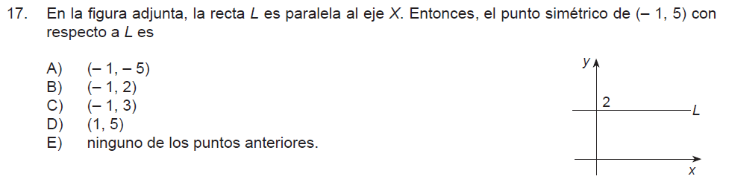


Slide 19
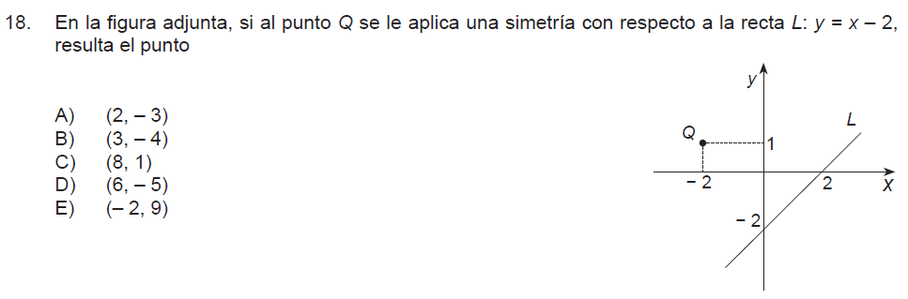
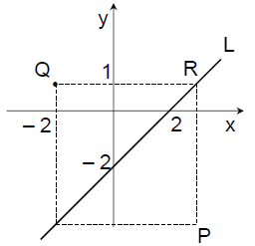

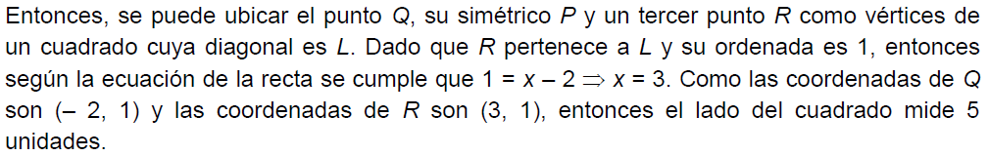

Slide 20
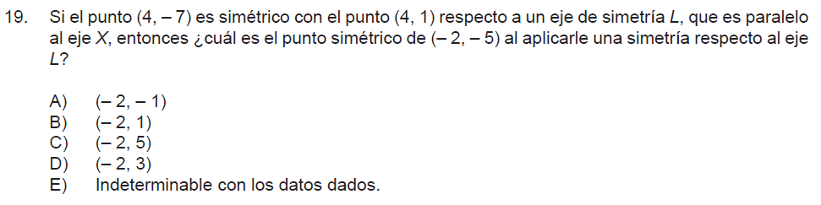


Slide 21
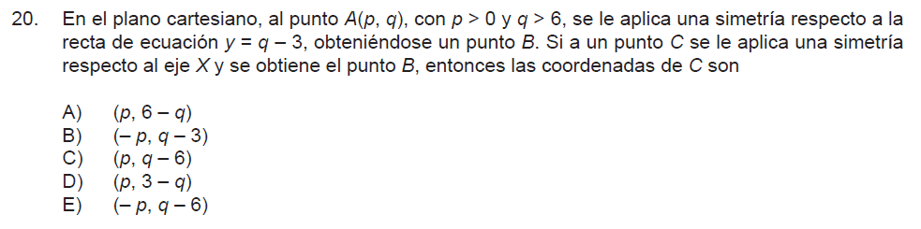
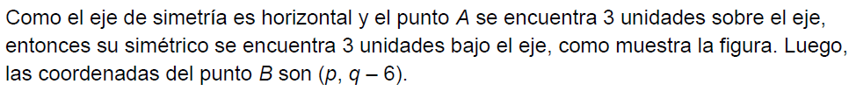
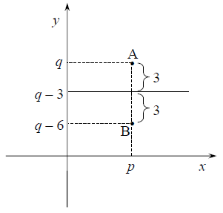
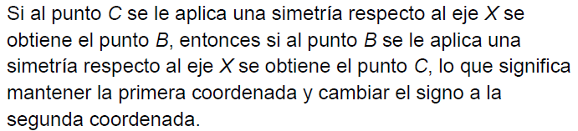

Slide 22
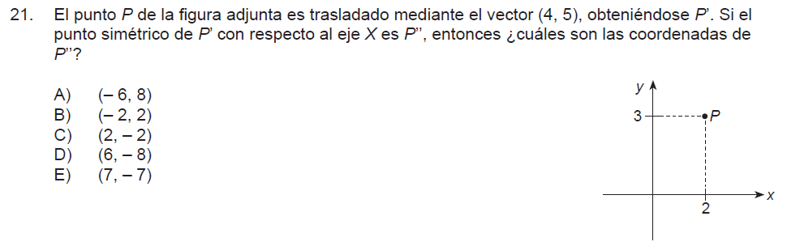




$$\left(2,3\right)+\left(4,5\right)=(6,8)$$
$$(2,3)$$
$(6,8)$ $respecto a eje X (x,−y)$
$$(6,−8)$$

Slide 23
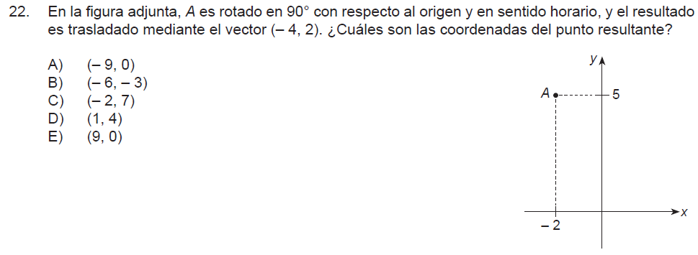
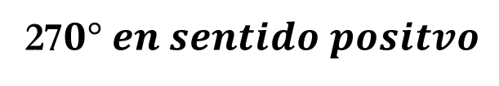


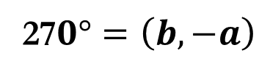

27$0° en sentido positvo$
27$0°=\left(b,−a\right)$
$$(−2,5)°$$
$$\left(b,−a\right)=(5,2)$$
$$\left(5,2\right)+\left(−4,2\right)=(1,4)$$

Slide 24
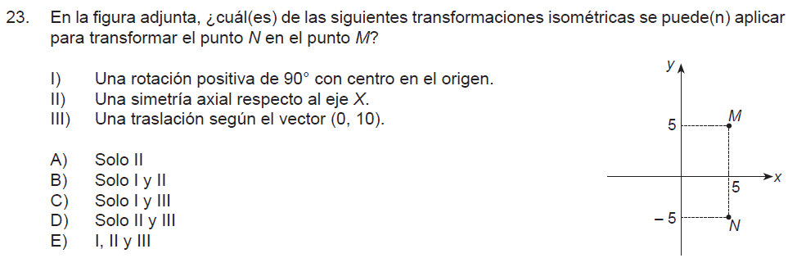





$$(5,5)$$
$$(5,−5)$$
$$I) \left(−b,a\right)=\left(5,−5\right)=(5,5)$$
$$II) \left(a,−b\right)=\left(5,5\right)=(5,−5)$$
$$III) \left(5,−5\right)+\left(0,10\right)=(5,5)$$

Slide 25
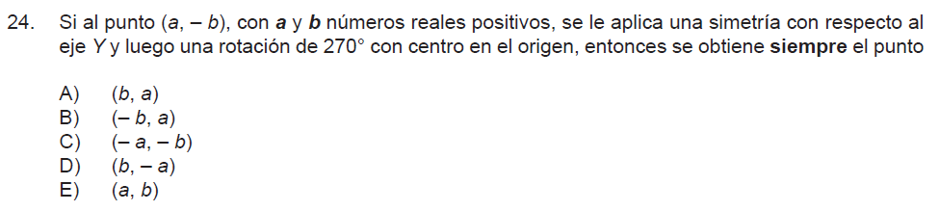

$$\left(a,−b\right)= eje y \left(−a,−b\right)=(−b,a)$$

Slide 26
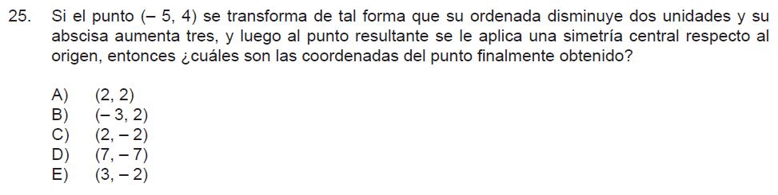


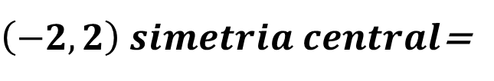

$$\left(−5,4\right)=\left(−5+3,4−2\right)=$$
$$\left(−2 , 2\right)$$
$\left(−2,2\right) simetria central$=
$$\left(2 , −2\right)$$

